Slide 1
Dynamic Programming

Slide 2
Longest Common Subsequence

Slide 3
Longest Common Subsequence
A subsequence of a given sequence is just the given sequence with zero or more elements left out. Formally, given a sequence X = ⟨x₁, x₂, . . ., x_{m}⟩ another sequence Z = ⟨z₁, z₂, . . ., z_{k}⟩ is a subsequence of X if there exists a strictly increasing sequence ⟨i₁, i₂, . . ., i_{k}⟩ of indices of X such that for all j = 1, 2, . . . , k, we have x_{ij} = z_{j}. For example, Z = ⟨b, c, d, b⟩ is a subsequence of X = ⟨a, b, c, b, d, a, b⟩ with corresponding index sequence ⟨2, 3, 5, 7⟩.

Slide 4
Longest Common Subsequence
Given two sequences X and Y, we say that a sequence Z is a common subsequence of X and Y if Z is a subsequence of both X and Y. For example, if X = ⟨a, b, c, b, d, a, b⟩ and Y = ⟨b, d, c, a, b, a⟩, the sequence ⟨b, c, a⟩ is a common subsequence of both X and Y. The sequence ⟨b, c, a⟩ is not a longest common subsequence (LCS) of X and Y, however, since it has length 3 and the sequence ⟨b, c, b, a⟩, which is also common to both X and Y, has length 4. The sequence ⟨b, c, b, a⟩ is an LCS of X and Y, as is the sequence ⟨b, d, a, b⟩, since X and Y have no common subsequence of length 5 or greater.
In the longest-common-subsequence problem, the input is two sequences X = ⟨x₁, x₂, . . ., x_{m}⟩ and Y = ⟨ y₁, y₂, . . ., y_{n}⟩, and the goal is to find a maximum length common subsequence of X and Y.

Slide 5
Step 1: Characterizing a Longest Common Subsequence
Theorem (Optimal substructure of an LCS)
Let X = ⟨x₁, x₂, . . ., x_{m}⟩ and Y = ⟨ y₁, y₂, . . ., y_{n}⟩ be sequences.
1. If x_{m} = y_{n}, let Z = ⟨z₁, z₂, . . ., z_{k}⟩ be an LCS of X_{m−1} and Y_{n−1}, then ⟨z₁, z₂, . . ., z_{k}, x_{m}⟩ is an LCS of X and Y.
2. If x_{m} ≠ y_{n}, let Z₁ be an LCS of X_{m−1} and Y, and let Z₂ be an LCS of X and Y_{n−1}, then the longer one of Z₁ and Z₂ is an LCS of X and Y.
X_{m−1} | x_{m}
Y_{n−1} | y_{n}

Slide 6
Step 1: Characterizing a Longest Common Subsequence
Theorem (Optimal substructure of an LCS)
Let X = ⟨x₁, x₂, . . ., x_{m}⟩ and Y = ⟨ y₁, y₂, . . ., y_{n}⟩ be sequences.
1. If x_{m} = y_{n}, let Z = ⟨z₁, z₂, . . ., z_{k}⟩ be an LCS of X_{m−1} and Y_{n−1}, then ⟨z₁, z₂, . . ., z_{k}, x_{m}⟩ is an LCS of X and Y.
2. If x_{m} ≠ y_{n}, let Z₁ be an LCS of X_{m−1} and Y, and let Z₂ be an LCS of X and Y_{n−1}, then the longer one of Z₁ and Z₂ is an LCS of X and Y.
X = ⟨a, b, c, b, d, a, b⟩ X = ⟨a, b, c, b, d, a, b⟩
Y = ⟨b, d, c, a, b, a⟩ Y = ⟨b, d, c, a, b, a⟩

Slide 7
Step 1: Characterizing a Longest Common Subsequence
Theorem (Optimal substructure of an LCS)
Let X = ⟨x₁, x₂, . . ., x_{m}⟩ and Y = ⟨ y₁, y₂, . . ., y_{n}⟩ be sequences.
1. If x_{m} = y_{n}, let Z = ⟨z₁, z₂, . . ., z_{k}⟩ be an LCS of X_{m−1} and Y_{n−1}, then ⟨z₁, z₂, . . ., z_{k}, x_{m}⟩ is an LCS of X and Y.
2. If x_{m} ≠ y_{n}, let Z₁ be an LCS of X_{m−1} and Y, and let Z₂ be an LCS of X and Y_{n−1}, then the longer one of Z₁ and Z₂ is an LCS of X and Y.
X = ⟨a, b, c, b, d, a, b⟩ X = ⟨a, b, c, b, d, a, b⟩
Y = ⟨b, d, c, a, b, a⟩ Y = ⟨b, d, c, a, b, a⟩

Slide 8
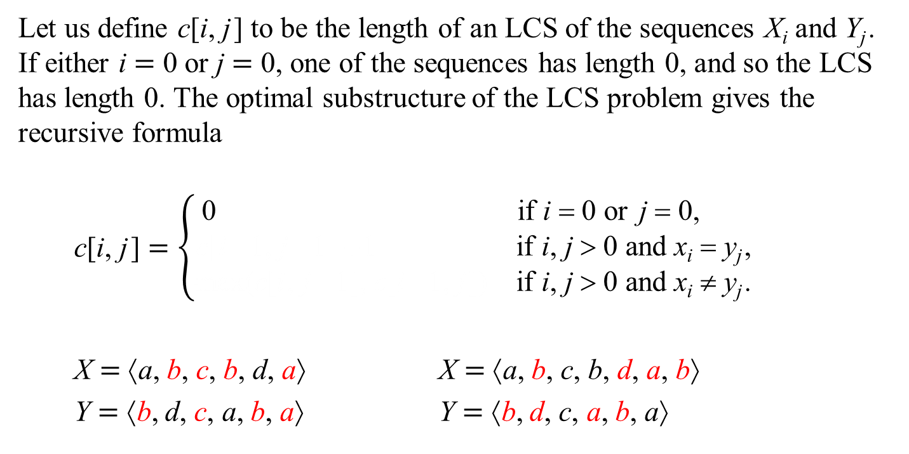
Step 2: A Recursive Solution
Let us define c[i, j] to be the length of an LCS of the sequences X_{i} and Y_{j}. If either i = 0 or j = 0, one of the sequences has length 0, and so the LCS has length 0. The optimal substructure of the LCS problem gives the recursive formula
$$\text{c}\text{[}\text{i}\text{,} \text{j}\text{]}=\left\{\begin{matrix}\text{0} & \text{if} \text{i} \text{=} \text{0 }\text{or} \text{j} \text{=} \text{0}\text{,} \\ \text{c}\text{[}\text{i}\text{−}\text{1}\text{,} \text{j}\text{−}\text{1]} \text{+}\text{1 } & \text{if} \text{i}\text{, }\text{j} \text{>} \text{0} \text{and} \text{x}\text{i} \text{=} \text{y}\text{j}\text{,} \\ \text{max}\text{(}\text{c}\text{[}\text{i}\text{,} \text{j}\text{−}\text{1]}\text{,} \text{c}\text{[}\text{i}\text{−}\text{1,} \text{j}\text{]}\text{)} & \text{if} \text{i}\text{, }\text{j} \text{>} \text{0} \text{and} \text{x}\text{i} ≠ \text{y}\text{j}\text{.}\end{matrix}\right.$$
X = ⟨a, b, c, b, d, a⟩ X = ⟨a, b, c, b, d, a, b⟩
Y = ⟨b, d, c, a, b, a⟩ Y = ⟨b, d, c, a, b, a⟩

Slide 9
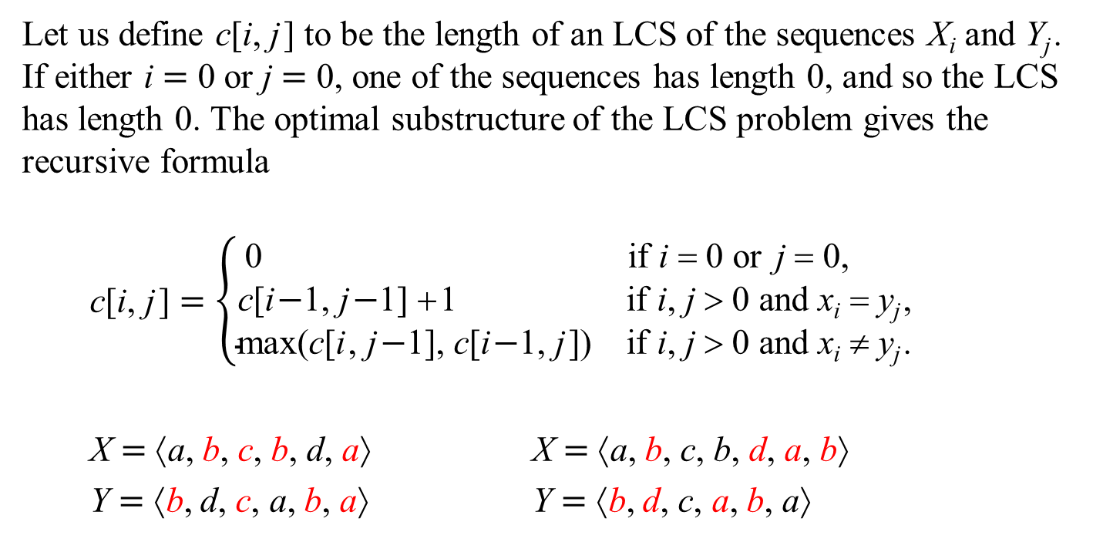
Step 2: A Recursive Solution
Let us define c[i, j] to be the length of an LCS of the sequences X_{i} and Y_{j}. If either i = 0 or j = 0, one of the sequences has length 0, and so the LCS has length 0. The optimal substructure of the LCS problem gives the recursive formula
$$\text{c}\text{[}\text{i}\text{,} \text{j}\text{]}=\left\{\begin{matrix}\text{0} & \text{if} \text{i} \text{=} \text{0 }\text{or} \text{j} \text{=} \text{0}\text{,} \\ \text{c}\text{[}\text{i}\text{−}\text{1}\text{,} \text{j}\text{−}\text{1]} \text{+}\text{1 } & \text{if} \text{i}\text{, }\text{j} \text{>} \text{0} \text{and} \text{x}\text{i} \text{=} \text{y}\text{j}\text{,} \\ \text{max}\text{(}\text{c}\text{[}\text{i}\text{,} \text{j}\text{−}\text{1]}\text{,} \text{c}\text{[}\text{i}\text{−}\text{1,} \text{j}\text{]}\text{)} & \text{if} \text{i}\text{, }\text{j} \text{>} \text{0} \text{and} \text{x}\text{i} ≠ \text{y}\text{j}\text{.}\end{matrix}\right.$$
X = ⟨a, b, c, b, d, a⟩ X = ⟨a, b, c, b, d, a, b⟩
Y = ⟨b, d, c, a, b, a⟩ Y = ⟨b, d, c, a, b, a⟩

Slide 10
A Recursive Algorithm

Slide 11
Step 3: Computing the Length of an LCS
int main()
{
while( getline( cin, s1 ) )
{
getline( cin, s2 );
size_t m = s1.size();
size_t n = s2.size();
s1.insert( s1.begin(), '\0' );
s2.insert( s2.begin(), '\0' );
for( size_t i = 1; i <= m; i++ )
for( size_t j = 1; j <= n; j++ )
lcs[ i ][ j ] = -1;
cout << findLCS( m, n ) << endl;
}
return 0;
}

Slide 12
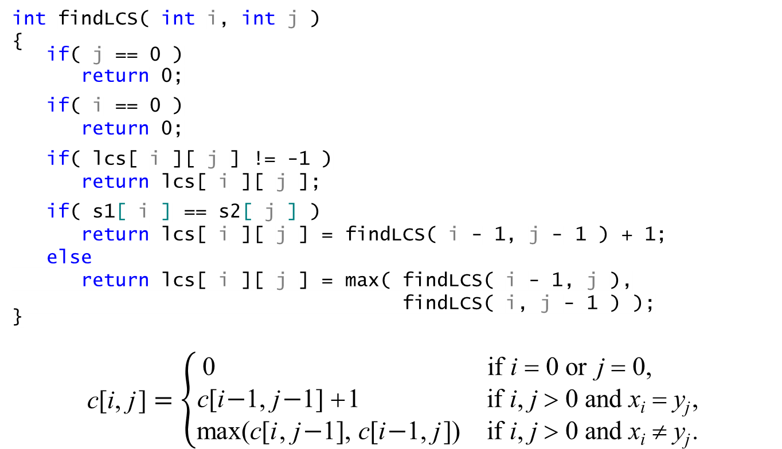
Step 3: Computing the Length of an LCS
int findLCS( int i, int j )
{
if( j == 0 )
return 0;
if( i == 0 )
return 0;
if( lcs[ i ][ j ] != -1 )
return lcs[ i ][ j ];
if( s1[ i ] == s2[ j ] )
return lcs[ i ][ j ] = findLCS( i - 1, j - 1 ) + 1;
else
return lcs[ i ][ j ] = max( findLCS( i - 1, j ),
findLCS( i, j - 1 ) );
}
$$\text{c}\text{[}\text{i}\text{,} \text{j}\text{]}=\left\{\begin{matrix}\text{0} & \text{if} \text{i} \text{=} \text{0 }\text{or} \text{j} \text{=} \text{0, } \\ \text{c}\text{[}\text{i}\text{−}\text{1,} \text{j}\text{−}\text{1] }\text{+}\text{1 } & \text{if} \text{i}\text{, }\text{j} \text{>} \text{0} \text{and} \text{x}\text{i} \text{=} \text{y}\text{j}\text{,} \\ \text{max}\text{(}\text{c}\text{[}\text{i}\text{,} \text{j}\text{−}\text{1],} \text{c}\text{[}\text{i}\text{−}\text{1,} \text{j}\text{])} & \text{if} \text{i}\text{, }\text{j} \text{>} \text{0} \text{and} \text{x}\text{i} ≠ \text{y}\text{j}\text{.}\end{matrix}\right.$$

Slide 13
An Iterative Algorithm

Slide 14
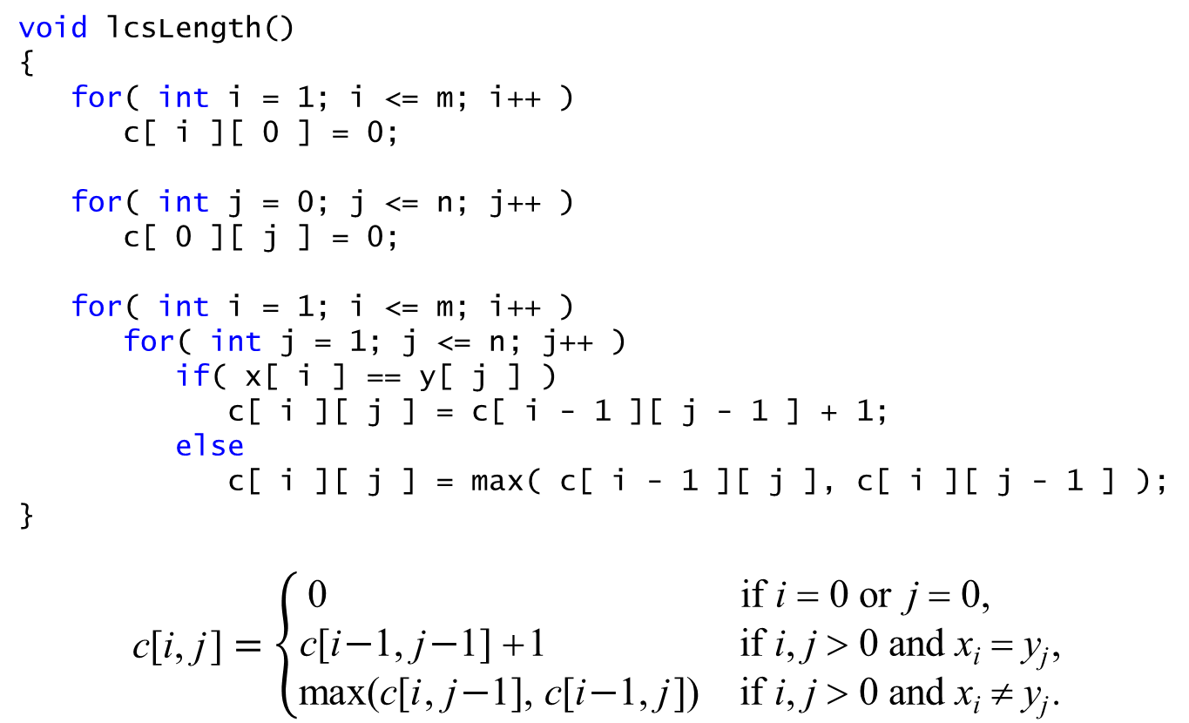
Step 3: Computing the Length of an LCS
void lcsLength()
{
for( int i = 1; i <= m; i++ )
c[ i ][ 0 ] = 0;
for( int j = 0; j <= n; j++ )
c[ 0 ][ j ] = 0;
for( int i = 1; i <= m; i++ )
for( int j = 1; j <= n; j++ )
if( x[ i ] == y[ j ] )
c[ i ][ j ] = c[ i - 1 ][ j - 1 ] + 1;
else
c[ i ][ j ] = max( c[ i - 1 ][ j ], c[ i ][ j - 1 ] );
}
$$\text{c}\text{[}\text{i}\text{,} \text{j}\text{]}=\left\{\begin{matrix}\text{0} & \text{if} \text{i} \text{=} \text{0 }\text{or} \text{j} \text{=} \text{0, } \\ \text{c}\text{[}\text{i}\text{−}\text{1,} \text{j}\text{−}\text{1] }\text{+}\text{1 } & \text{if} \text{i}\text{, }\text{j} \text{>} \text{0} \text{and} \text{x}\text{i} \text{=} \text{y}\text{j}\text{,} \\ \text{max}\text{(}\text{c}\text{[}\text{i}\text{,} \text{j}\text{−}\text{1],} \text{c}\text{[}\text{i}\text{−}\text{1,} \text{j}\text{])} & \text{if} \text{i}\text{, }\text{j} \text{>} \text{0} \text{and} \text{x}\text{i} ≠ \text{y}\text{j}\text{.}\end{matrix}\right.$$

Slide 15
Step 3: Computing the Length of an LCS
c | j | 0 | 1 | 2 | 3 | 4 | 5 | 6
i |  | y_{j} | b | d | c | a | b | a
0 | x_{i} | 0 | 0 | 0 | 0 | 0 | 0 | 0
1 | a | 0 | 0 | 0 | 0 | 1 | 1 | 1
2 | b | 0 | 1 | 1 | 1 | 1 | 2 | 2
3 | c | 0 | 1 | 1 | 2 | 2 | 2 | 2
4 | b | 0 | 1 | 1 | 2 | 2 | 3 | 3
5 | d | 0 | 1 | 2 | 2 | 2 | 3 | 3
6 | a | 0 | 1 | 2 | 2 | 3 | 3 | 4
7 | b | 0 | 1 | 2 | 2 | 3 | 4 | 4
void lcsLength()
{
for( int i = 1; i <= m; i++ )
c[ i ][ 0 ] = 0;
for( int j = 0; j <= n; j++ )
c[ 0 ][ j ] = 0;
for( int i = 1; i <= m; i++ )
for( int j = 1; j <= n; j++ )
if( x[ i ] == y[ j ] )
c[ i ][ j ] = c[ i - 1 ][ j - 1 ] + 1;
else
c[ i ][ j ] = max( c[ i - 1 ][ j ], c[ i ][ j - 1 ] );
}

Slide 16
Step 3: Computing the Length of an LCS
The worst-case time complexity of the function is Θ(mn), since each table entry takes Θ(1) time to compute.

Slide 17
Constructing an LCS
c | j | 0 | 1 | 2 | 3 | 4 | 5 | 6
i |  | y_{j} | b | d | c | a | b | a
0 | x_{i} | 0 | 0 | 0 | 0 | 0 | 0 | 0
1 | a | 0 | 0 | 0 | 0 | 1 | 1 | 1
2 | b | 0 | 1 | 1 | 1 | 1 | 2 | 2
3 | c | 0 | 1 | 1 | 2 | 2 | 2 | 2
4 | b | 0 | 1 | 1 | 2 | 2 | 3 | 3
5 | d | 0 | 1 | 2 | 2 | 2 | 3 | 3
6 | a | 0 | 1 | 2 | 2 | 3 | 3 | 4
7 | b | 0 | 1 | 2 | 2 | 3 | 4 | 4
void printLCS( int i, int j )
{
if( i == 0 || j == 0 )
return;
if( x[ i ] == y[ j ] )
{
printLCS( i - 1, j - 1 );
cout << setw( 3 ) << x[ i ];
}
else if( c[ i - 1 ][ j ] >= c[ i ][ j - 1 ] )
printLCS( i - 1, j );
else
printLCS( i, j - 1 );
}

Slide 18
Constructing an LCS
c | j | 0 | 1 | 2 | 3 | 4 | 5 | 6
i |  | y_{j} | b | d | c | a | b | a
0 | x_{i} | 0 | 0 | 0 | 0 | 0 | 0 | 0
1 | a | 0 | 0 | 0 | 0 | 1 | 1 | 1
2 | b | 0 | 1 | 1 | 1 | 1 | 2 | 2
3 | c | 0 | 1 | 1 | 2 | 2 | 2 | 2
4 | b | 0 | 1 | 1 | 2 | 2 | 3 | 3
5 | d | 0 | 1 | 2 | 2 | 2 | 3 | 3
6 | a | 0 | 1 | 2 | 2 | 3 | 3 | 4
7 | b | 0 | 1 | 2 | 2 | 3 | 4 | 4
void printLCS( int i, int j )
{
if( i == 0 || j == 0 )
return;
if( x[ i ] == y[ j ] )
{
printLCS( i - 1, j - 1 );
cout << setw( 3 ) << x[ i ];
}
else if( c[ i - 1 ][ j ] >= c[ i ][ j - 1 ] )
printLCS( i - 1, j );
else
printLCS( i, j - 1 );
}

Slide 19
Constructing an LCS
c | j | 0 | 1 | 2 | 3 | 4 | 5 | 6
i |  | y_{j} | b | d | c | a | b | a
0 | x_{i} | 0 | 0 | 0 | 0 | 0 | 0 | 0
1 | a | 0 | 0 | 0 | 0 | 1 | 1 | 1
2 | b | 0 | 1 | 1 | 1 | 1 | 2 | 2
3 | c | 0 | 1 | 1 | 2 | 2 | 2 | 2
4 | b | 0 | 1 | 1 | 2 | 2 | 3 | 3
5 | d | 0 | 1 | 2 | 2 | 2 | 3 | 3
6 | a | 0 | 1 | 2 | 2 | 3 | 3 | 4
7 | b | 0 | 1 | 2 | 2 | 3 | 4 | 4
void printLCS( int i, int j )
{
if( i == 0 || j == 0 )
return;
if( x[ i ] == y[ j ] )
{
printLCS( i - 1, j - 1 );
cout << setw( 3 ) << x[ i ];
}
else if( c[ i - 1 ][ j ] >= c[ i ][ j - 1 ] )
printLCS( i - 1, j );
else
printLCS( i, j - 1 );
}

Slide 20
Step 4: Constructing an LCS
void printLCS( int i, int j )
{
if( i == 0 || j == 0 )
return;
if( x[ i ] == y[ j ] )
{
printLCS( i - 1, j - 1 );
cout << setw( 3 ) << x[ i ];
}
else if( c[ i - 1 ][ j ] >= c[ i ][ j - 1 ] )
printLCS( i - 1, j );
else
printLCS( i, j - 1 );
}

Slide 21
Use One-dimensional Array

Slide 22
Step 3: Computing the Length of an LCS
c | j | 0 | 1 | 2 | 3 | 4 | 5 | 6
i |  | y_{j} | b | d | c | a | b | a
0 | x_{i} | 0 | 0 | 0 | 0 | 0 | 0 | 0
1 | a | 0 | 0 | 0 | 0 | 1 | 1 | 1
2 | b | 0 | 1 | 1 | 1 | 1 | 2 | 2
3 | c | 0 | 1 | 1 | 2 | 2 | 2 | 2
4 | b | 0 | 1 | 1 | 2 | 2 | 3 | 3
5 | d | 0 | 1 | 2 | 2 | 2 | 3 | 3
6 | a | 0 | 1 | 2 | 2 | 3 | 3 | 4
7 | b | 0 | 1 | 2 | 2 | 3 | 4 | 4
void lcsLength()
{
for( int i = 1; i <= m; i++ )
c[ i ][ 0 ] = 0;
for( int j = 0; j <= n; j++ )
c[ 0 ][ j ] = 0;
for( int i = 1; i <= m; i++ )
for( int j = 1; j <= n; j++ )
if( x[ i ] == y[ j ] )
c[ i ][ j ] = c[ i - 1 ][ j - 1 ] + 1;
else
c[ i ][ j ] = max( c[ i - 1 ][ j ], c[ i ][ j - 1 ] );
}
i |  | y_{j} | b | d | c | c | b | a
1 | a | 0 | 0 | 0 | 0 | 0 | 0 | 0

Slide 23
Step 3: Computing the Length of an LCS
c | j | 0 | 1 | 2 | 3 | 4 | 5 | 6
i |  | y_{j} | b | d | c | a | b | a
0 | x_{i} | 0 | 0 | 0 | 0 | 0 | 0 | 0
1 | a | 0 | 0 | 0 | 0 | 1 | 1 | 1
2 | b | 0 | 1 | 1 | 1 | 1 | 2 | 2
3 | c | 0 | 1 | 1 | 2 | 2 | 2 | 2
4 | b | 0 | 1 | 1 | 2 | 2 | 3 | 3
5 | d | 0 | 1 | 2 | 2 | 2 | 3 | 3
6 | a | 0 | 1 | 2 | 2 | 3 | 3 | 4
7 | b | 0 | 1 | 2 | 2 | 3 | 4 | 4
void lcsLength()
{
for( int i = 1; i <= m; i++ )
c[ i ][ 0 ] = 0;
for( int j = 0; j <= n; j++ )
c[ 0 ][ j ] = 0;
for( int i = 1; i <= m; i++ )
for( int j = 1; j <= n; j++ )
if( x[ i ] == y[ j ] )
c[ i ][ j ] = c[ i - 1 ][ j - 1 ] + 1;
else
c[ i ][ j ] = max( c[ i - 1 ][ j ], c[ i ][ j - 1 ] );
}

Slide 24
Step 3: Computing the Length of an LCS
c | j | 0 | 1 | 2 | 3 | 4 | 5 | 6
i |  | y_{j} | b | d | c | a | b | a
0 | x_{i} | 0 | 0 | 0 | 0 | 0 | 0 | 0
1 | a | 0 | 0 | 0 | 0 | 1 | 1 | 1
2 | b | 0 | 1 | 1 | 1 | 1 | 2 | 2
3 | c | 0 | 1 | 1 | 2 | 2 | 2 | 2
4 | b | 0 | 1 | 1 | 2 | 2 | 3 | 3
5 | d | 0 | 1 | 2 | 2 | 2 | 3 | 3
6 | a | 0 | 1 | 2 | 2 | 3 | 3 | 4
7 | b | 0 | 1 | 2 | 2 | 3 | 4 | 4
void lcsLength()
{
for( int i = 1; i <= m; i++ )
c[ i ][ 0 ] = 0;
for( int j = 0; j <= n; j++ )
c[ 0 ][ j ] = 0;
for( int i = 1; i <= m; i++ )
for( int j = 1; j <= n; j++ )
if( x[ i ] == y[ j ] )
c[ i ][ j ] = c[ i - 1 ][ j - 1 ] + 1;
else if( c[ i - 1 ][ j ] >= c[ i ][ j - 1 ] )
c[ i ][ j ] = c[ i - 1 ][ j ];
else
c[ i ][ j ] = c[ i ][ j - 1 ];
}

Slide 25
Step 3: Computing the Length of an LCS
c | j | 0 | 1 | 2 | 3 | 4 | 5 | 6
i |  | y_{j} | b | d | c | a | b | a
0 | x_{i} | 0 | 0 | 0 | 0 | 0 | 0 | 0
1 | a | 0 | 0 | 0 | 0 | 1 | 1 | 1
2 | b | 0 | 1 | 1 | 1 | 1 | 2 | 2
3 | c | 0 | 1 | 1 | 2 | 2 | 2 | 2
4 | b | 0 | 1 | 1 | 2 | 2 | 3 | 3
5 | d | 0 | 1 | 2 | 2 | 2 | 3 | 3
6 | a | 0 | 1 | 2 | 2 | 3 | 3 | 4
7 | b | 0 | 1 | 2 | 2 | 3 | 4 | 4
void lcsLength()
{
for( int i = 1; i <= m; i++ )
c[ i ][ 0 ] = 0;
for( int j = 0; j <= n; j++ )
c[ 0 ][ j ] = 0;
for( int i = 1; i <= m; i++ )
for( int j = 1; j <= n; j++ )
if( x[ i ] == y[ j ] )
c[ i ][ j ] = c[ i - 1 ][ j - 1 ] + 1;
else if( c[ i - 1 ][ j ] >= c[ i ][ j - 1 ] )
c[ i ][ j ] = c[ i - 1 ][ j ];
else
c[ i ][ j ] = c[ i ][ j - 1 ];
}

Slide 26
Step 3: Computing the Length of an LCS
c | j | 0 | 1 | 2 | 3 | 4 | 5 | 6
i |  | y_{j} | b | d | c | a | b | a
0 | x_{i} | 0 | 0 | 0 | 0 | 0 | 0 | 0
1 | a | 0 | 0 | 0 | 0 | 1 | 1 | 1
2 | b | 0 | 1 | 1 | 1 | 1 | 2 | 2
3 | c | 0 | 1 | 1 | 2 | 2 | 2 | 2
4 | b | 0 | 1 | 1 | 2 | 2 | 3 | 3
5 | d | 0 | 1 | 2 | 2 | 2 | 3 | 3
6 | a | 0 | 1 | 2 | 2 | 3 | 3 | 4
7 | b | 0 | 1 | 2 | 2 | 3 | 4 | 4
void lcsLength()
{
for( int i = 1; i <= m; i++ )
c[ i ][ 0 ] = 0;
for( int j = 0; j <= n; j++ )
c[ j ] = 0;
for( int i = 1; i <= m; i++ )
for( int j = 1; j <= n; j++ )
if( x[ i ] == y[ j ] )
c[ j ] = c[ j - 1 ] + 1;
else if( c[ j ] >= c[ j - 1 ] )
c[ j ] = c[ j ];
else
c[ j ] = c[ j - 1 ];
}

Slide 27
Step 3: Computing the Length of an LCS
c | j | 0 | 1 | 2 | 3 | 4 | 5 | 6
i |  | y_{j} | b | d | c | a | b | a
0 | x_{i} | 0 | 0 | 0 | 0 | 0 | 0 | 0
1 | a | 0 | 0 | 0 | 0 | 1 | 1 | 1
2 | b | 0 | 1 | 1 | 1 | 1 | 2 | 2
3 | c | 0 | 1 | 1 | 2 | 2 | 2 | 2
4 | b | 0 | 1 | 1 | 2 | 2 | 3 | 3
5 | d | 0 | 1 | 2 | 2 | 2 | 3 | 3
6 | a | 0 | 1 | 2 | 2 | 3 | 3 | 4
7 | b | 0 | 1 | 2 | 2 | 3 | 4 | 4
void lcsLength()
{
for( int i = 1; i <= m; i++ )
c[ i ][ 0 ] = 0;
for( int j = 0; j <= n; j++ )
c[ j ] = 0;
for( int i = 1; i <= m; i++ )
for( int j = 1; j <= n; j++ )
if( x[ i ] == y[ j ] )
c[ j ] = c[ j - 1 ] + 1;
else if( c[ j ] >= c[ j - 1 ] )
c[ j ] = c[ j ];
else
c[ j ] = c[ j - 1 ];
}

Slide 28
Step 3: Computing the Length of an LCS
c | j | 0 | 1 | 2 | 3 | 4 | 5 | 6
i |  | y_{j} | b | d | c | a | b | a
0 | x_{i} | 0 | 0 | 0 | 0 | 0 | 0 | 0
1 | a | 0 | 0 | 0 | 0 | 1 | 1 | 1
2 | b | 0 | 1 | 1 | 1 | 1 | 2 | 2
3 | c | 0 | 1 | 1 | 2 | 2 | 2 | 2
4 | b | 0 | 1 | 1 | 2 | 2 | 3 | 3
5 | d | 0 | 1 | 2 | 2 | 2 | 3 | 3
6 | a | 0 | 1 | 2 | 2 | 3 | 3 | 4
7 | b | 0 | 1 | 2 | 2 | 3 | 4 | 4
void lcsLength()
{
for( int i = 1; i <= m; i++ )
c[ i ][ 0 ] = 0;
for( int j = 0; j <= n; j++ )
c[ j ] = 0;
for( int i = 1; i <= m; i++ )
for( int j = 1; j <= n; j++ )
if( x[ i ] == y[ j ] )
c[ j ] = c[ j - 1 ] + 1;
else if( c[ j ] < c[ j - 1 ] )
c[ j ] = c[ j ];
else
c[ j ] = c[ j - 1 ];
}

Slide 29
Step 3: Computing the Length of an LCS
c | j | 0 | 1 | 2 | 3 | 4 | 5 | 6
i |  | y_{j} | b | d | c | a | b | a
0 | x_{i} | 0 | 0 | 0 | 0 | 0 | 0 | 0
1 | a | 0 | 0 | 0 | 0 | 1 | 1 | 1
2 | b | 0 | 1 | 1 | 1 | 1 | 2 | 2
3 | c | 0 | 1 | 1 | 2 | 2 | 2 | 2
4 | b | 0 | 1 | 1 | 2 | 2 | 3 | 3
5 | d | 0 | 1 | 2 | 2 | 2 | 3 | 3
6 | a | 0 | 1 | 2 | 2 | 3 | 3 | 4
7 | b | 0 | 1 | 2 | 2 | 3 | 4 | 4
void lcsLength()
{
for( int j = 0; j <= n; j++ )
c[ j ] = 0;
for( int i = 1; i <= m; i++ )
for( int j = 1; j <= n; j++ )
if( x[ i ] == y[ j ] )
c[ j ] = c[ j - 1 ] + 1;
else if( c[ j ] < c[ j - 1 ] )
c[ j ] = c[ j - 1 ];
}

Slide 30
Using An 1-d Array
void lcsLength()
{
for( int j = 0; j <= n; j++ )
c[ j ] = 0;
for( int i = 1; i <= m; i++ )
for( int j = 1; j <= n; j++ )
if( x[ i ] == y[ j ] )
c[ j ] = c[ j - 1 ] + 1;
else if( c[ j ] < c[ j - 1 ] )
c[ j ] = c[ j - 1 ];
}
c | j | 0 | 1 | 2 | 3 | 4 | 5 | 6
i |  | y_{j} | b | d | c | c | b | a
0 | x_{i} | 0 | 0 | 0 | 0 | 0 | 0 | 0
1 | a | 0 | 0 | 0 | 0 | 0 | 0 | 1
2 | b | 0 | 1 | 1 | 1 | 1 | 1 | 1
3 | c | 0 | 1 | 1 | 2 | 2 | 2 | 2
4 | b | 0 | 1 | 1 | 2 | 2 | 3 | 3
5 | d | 0 | 1 | 2 | 2 | 2 | 3 | 3
6 | a | 0 | 1 | 2 | 2 | 2 | 3 | 4
7 | b | 0 | 1 | 2 | 2 | 2 | 3 | 4
 | c | j | 0 | 1 | 2 | 3 | 4 | 5 | 6
 | i |  | y_{j} | b | d | c | c | b | a
x_{i} | 1 | a | 0 | 0 | 0 | 0 | 0 | 0 | 0

Slide 31
Using An 1-d Array
void lcsLength()
{
for( int j = 0; j <= n; j++ )
c[ j ] = 0;
for( int i = 1; i <= m; i++ )
for( int j = 1; j <= n; j++ )
if( x[ i ] == y[ j ] )
c[ j ] = c[ j - 1 ] + 1;
else if( c[ j ] < c[ j - 1 ] )
c[ j ] = c[ j - 1 ];
}
c | j | 0 | 1 | 2 | 3 | 4 | 5 | 6
i |  | y_{j} | b | d | c | c | b | a
0 | x_{i} | 0 | 0 | 0 | 0 | 0 | 0 | 0
1 | a | 0 | 0 | 0 | 0 | 0 | 0 | 1
2 | b | 0 | 1 | 1 | 1 | 1 | 1 | 1
3 | c | 0 | 1 | 1 | 2 | 2 | 2 | 2
4 | b | 0 | 1 | 1 | 2 | 2 | 3 | 3
5 | d | 0 | 1 | 2 | 2 | 2 | 3 | 3
6 | a | 0 | 1 | 2 | 2 | 2 | 3 | 4
7 | b | 0 | 1 | 2 | 2 | 2 | 3 | 4
 | c | j | 0 | 1 | 2 | 3 | 4 | 5 | 6
 | i |  | y_{j} | b | d | c | c | b | a
x_{i} | 1 | a | 0 | 0 | 0 | 0 | 0 | 0 | 0

Slide 32
Using An 1-d Array
void lcsLength()
{
for( int j = 0; j <= n; j++ )
c[ j ] = 0;
for( int i = 1; i <= m; i++ )
for( int j = 1; j <= n; j++ )
if( x[ i ] == y[ j ] )
c[ j ] = c[ j - 1 ] + 1;
else if( c[ j ] < c[ j - 1 ] )
c[ j ] = c[ j - 1 ];
}
c | j | 0 | 1 | 2 | 3 | 4 | 5 | 6
i |  | y_{j} | b | d | c | c | b | a
0 | x_{i} | 0 | 0 | 0 | 0 | 0 | 0 | 0
1 | a | 0 | 0 | 0 | 0 | 0 | 0 | 1
2 | b | 0 | 1 | 1 | 1 | 1 | 1 | 1
3 | c | 0 | 1 | 1 | 2 | 2 | 2 | 2
4 | b | 0 | 1 | 1 | 2 | 2 | 3 | 3
5 | d | 0 | 1 | 2 | 2 | 2 | 3 | 3
6 | a | 0 | 1 | 2 | 2 | 2 | 3 | 4
7 | b | 0 | 1 | 2 | 2 | 2 | 3 | 4
 | c | j | 0 | 1 | 2 | 3 | 4 | 5 | 6
 | i |  | y_{j} | b | d | c | c | b | a
x_{i} | 1 | a | 0 | 0 | 0 | 0 | 0 | 0 | 1

Slide 33
Using An 1-d Array
void lcsLength()
{
for( int j = 0; j <= n; j++ )
c[ j ] = 0;
for( int i = 1; i <= m; i++ )
for( int j = 1; j <= n; j++ )
if( x[ i ] == y[ j ] )
c[ j ] = c[ j - 1 ] + 1;
else if( c[ j ] < c[ j - 1 ] )
c[ j ] = c[ j - 1 ];
}
c | j | 0 | 1 | 2 | 3 | 4 | 5 | 6
i |  | y_{j} | b | d | c | c | b | a
0 | x_{i} | 0 | 0 | 0 | 0 | 0 | 0 | 0
1 | a | 0 | 0 | 0 | 0 | 0 | 0 | 1
2 | b | 0 | 1 | 1 | 1 | 1 | 1 | 1
3 | c | 0 | 1 | 1 | 2 | 2 | 2 | 2
4 | b | 0 | 1 | 1 | 2 | 2 | 3 | 3
5 | d | 0 | 1 | 2 | 2 | 2 | 3 | 3
6 | a | 0 | 1 | 2 | 2 | 2 | 3 | 4
7 | b | 0 | 1 | 2 | 2 | 2 | 3 | 4
 | c | j | 0 | 1 | 2 | 3 | 4 | 5 | 6
 | i |  | y_{j} | b | d | c | c | b | a
x_{i} | 2 | b | 0 | 0 | 0 | 0 | 0 | 0 | 1

Slide 34
Using An 1-d Array
void lcsLength()
{
for( int j = 0; j <= n; j++ )
c[ j ] = 0;
for( int i = 1; i <= m; i++ )
for( int j = 1; j <= n; j++ )
if( x[ i ] == y[ j ] )
c[ j ] = c[ j - 1 ] + 1;
else if( c[ j ] < c[ j - 1 ] )
c[ j ] = c[ j - 1 ];
}
c | j | 0 | 1 | 2 | 3 | 4 | 5 | 6
i |  | y_{j} | b | d | c | c | b | a
0 | x_{i} | 0 | 0 | 0 | 0 | 0 | 0 | 0
1 | a | 0 | 0 | 0 | 0 | 0 | 0 | 1
2 | b | 0 | 1 | 1 | 1 | 1 | 1 | 1
3 | c | 0 | 1 | 1 | 2 | 2 | 2 | 2
4 | b | 0 | 1 | 1 | 2 | 2 | 3 | 3
5 | d | 0 | 1 | 2 | 2 | 2 | 3 | 3
6 | a | 0 | 1 | 2 | 2 | 2 | 3 | 4
7 | b | 0 | 1 | 2 | 2 | 2 | 3 | 4
 | c | j | 0 | 1 | 2 | 3 | 4 | 5 | 6
 | i |  | y_{j} | b | d | c | c | b | a
x_{i} | 2 | b | 0 | 1 | 0 | 0 | 0 | 0 | 1

Slide 35
Using An 1-d Array
void lcsLength()
{
for( int j = 0; j <= n; j++ )
c[ j ] = 0;
for( int i = 1; i <= m; i++ )
for( int j = 1; j <= n; j++ )
if( x[ i ] == y[ j ] )
c[ j ] = c[ j - 1 ] + 1;
else if( c[ j ] < c[ j - 1 ] )
c[ j ] = c[ j - 1 ];
}
c | j | 0 | 1 | 2 | 3 | 4 | 5 | 6
i |  | y_{j} | b | d | c | c | b | a
0 | x_{i} | 0 | 0 | 0 | 0 | 0 | 0 | 0
1 | a | 0 | 0 | 0 | 0 | 0 | 0 | 1
2 | b | 0 | 1 | 1 | 1 | 1 | 1 | 1
3 | c | 0 | 1 | 1 | 2 | 2 | 2 | 2
4 | b | 0 | 1 | 1 | 2 | 2 | 3 | 3
5 | d | 0 | 1 | 2 | 2 | 2 | 3 | 3
6 | a | 0 | 1 | 2 | 2 | 2 | 3 | 4
7 | b | 0 | 1 | 2 | 2 | 2 | 3 | 4
 | c | j | 0 | 1 | 2 | 3 | 4 | 5 | 6
 | i |  | y_{j} | b | d | c | c | b | a
x_{i} | 2 | b | 0 | 1 | 1 | 1 | 1 | 0 | 1

Slide 36
Using An 1-d Array
void lcsLength()
{
for( int j = 0; j <= n; j++ )
c[ j ] = 0;
for( int i = 1; i <= m; i++ )
for( int j = 1; j <= n; j++ )
if( x[ i ] == y[ j ] )
c[ j ] = c[ j - 1 ] + 1;
else if( c[ j ] < c[ j - 1 ] )
c[ j ] = c[ j - 1 ];
}
c | j | 0 | 1 | 2 | 3 | 4 | 5 | 6
i |  | y_{j} | b | d | c | c | b | a
0 | x_{i} | 0 | 0 | 0 | 0 | 0 | 0 | 0
1 | a | 0 | 0 | 0 | 0 | 0 | 0 | 1
2 | b | 0 | 1 | 1 | 1 | 1 | 1 | 1
3 | c | 0 | 1 | 1 | 2 | 2 | 2 | 2
4 | b | 0 | 1 | 1 | 2 | 2 | 3 | 3
5 | d | 0 | 1 | 2 | 2 | 2 | 3 | 3
6 | a | 0 | 1 | 2 | 2 | 2 | 3 | 4
7 | b | 0 | 1 | 2 | 2 | 2 | 3 | 4
 | c | j | 0 | 1 | 2 | 3 | 4 | 5 | 6
 | i |  | y_{j} | b | d | c | c | b | a
x_{i} | 2 | b | 0 | 1 | 1 | 1 | 1 | 2 | 1

Slide 38
Using An 1-d Array
void lcsLength()
{
for( int j = 0; j <= n; j++ )
c[ j ] = 0;
for( int i = 1; i <= m; i++ )
{
for( int j = 1; j <= n; j++ )
{
if( x[ i ] == y[ j ] )
c[ j ] = c[ j - 1 ] + 1;
else if( c[ j ] < c[ j - 1 ] )
c[ j ] = c[ j - 1 ];
}
}
}

Slide 39
Using An 1-d Array
void lcsLength()
{
for( int j = 0; j <= n; j++ )
c[ j ] = 0;
for( int i = 1; i <= m; i++ )
{
for( int j = 1; j <= n; j++ )
{
if( x[ i ] == y[ j ] )
c[ j ] = c[ j - 1 ] + 1;
if( x[ i ] != y[ j ] && c[ j ] < c[ j - 1 ] )
c[ j ] = c[ j - 1 ];
}
}
}

Slide 40
Using An 1-d Array
void lcsLength()
{
for( int j = 0; j <= n; j++ )
c[ j ] = 0;
for( int i = 1; i <= m; i++ )
{
for( int j = 1; j <= n; j++ )
if( x[ i ] == y[ j ] )
c[ j ] = c[ j - 1 ] + 1;
for( int j = 1; j <= n; j++ )
if( x[ i ] != y[ j ] && c[ j ] < c[ j - 1 ] )
c[ j ] = c[ j - 1 ];
}
}

Slide 41
c | j | 0 | 1 | 2 | 3 | 4 | 5 | 6
i |  | y_{j} | b | d | c | c | b | a
0 | x_{i} | 0 | 0 | 0 | 0 | 0 | 0 | 0
1 | a | 0 | 0 | 0 | 0 | 0 | 0 | 1
2 | b | 0 | 1 | 1 | 1 | 1 | 1 | 1
3 | c | 0 | 1 | 1 | 2 | 2 | 2 | 2
4 | b | 0 | 1 | 1 | 2 | 2 | 3 | 3
5 | d | 0 | 1 | 2 | 2 | 2 | 3 | 3
6 | a | 0 | 1 | 2 | 2 | 2 | 3 | 4
7 | b | 0 | 1 | 2 | 2 | 2 | 3 | 4
 | c | j | 0 | 1 | 2 | 3 | 4 | 5 | 6
 | i |  | y_{j} | b | d | c | c | b | a
x_{i} | 3 | c | 0 | 1 | 1 | 1 | 1 | 1 | 1
void lcsLength()
{
for( int j = 0; j <= n; j++ )
c[ j ] = 0;
for( int i = 1; i <= m; i++ )
{
for( int j = 1; j <= n; j++ )
if( x[ i ] == y[ j ] )
c[ j ] = c[ j - 1 ] + 1;
for( int j = 1; j <= n; j++ )
if( x[ i ] != y[ j ] && c[ j ] < c[ j - 1 ] )
c[ j ] = c[ j - 1 ];
}
}

Slide 42
c | j | 0 | 1 | 2 | 3 | 4 | 5 | 6
i |  | y_{j} | b | d | c | c | b | a
0 | x_{i} | 0 | 0 | 0 | 0 | 0 | 0 | 0
1 | a | 0 | 0 | 0 | 0 | 0 | 0 | 1
2 | b | 0 | 1 | 1 | 1 | 1 | 1 | 1
3 | c | 0 | 1 | 1 | 2 | 2 | 2 | 2
4 | b | 0 | 1 | 1 | 2 | 2 | 3 | 3
5 | d | 0 | 1 | 2 | 2 | 2 | 3 | 3
6 | a | 0 | 1 | 2 | 2 | 2 | 3 | 4
7 | b | 0 | 1 | 2 | 2 | 2 | 3 | 4
 | c | j | 0 | 1 | 2 | 3 | 4 | 5 | 6
 | i |  | y_{j} | b | d | c | c | b | a
x_{i} | 3 | c | 0 | 1 | 1 | 2 | 1 | 1 | 1
void lcsLength()
{
for( int j = 0; j <= n; j++ )
c[ j ] = 0;
for( int i = 1; i <= m; i++ )
{
for( int j = 1; j <= n; j++ )
if( x[ i ] == y[ j ] )
c[ j ] = c[ j - 1 ] + 1;
for( int j = 1; j <= n; j++ )
if( x[ i ] != y[ j ] && c[ j ] < c[ j - 1 ] )
c[ j ] = c[ j - 1 ];
}
}

Slide 43
c | j | 0 | 1 | 2 | 3 | 4 | 5 | 6
i |  | y_{j} | b | d | c | c | b | a
0 | x_{i} | 0 | 0 | 0 | 0 | 0 | 0 | 0
1 | a | 0 | 0 | 0 | 0 | 0 | 0 | 1
2 | b | 0 | 1 | 1 | 1 | 1 | 1 | 1
3 | c | 0 | 1 | 1 | 2 | 2 | 2 | 2
4 | b | 0 | 1 | 1 | 2 | 2 | 3 | 3
5 | d | 0 | 1 | 2 | 2 | 2 | 3 | 3
6 | a | 0 | 1 | 2 | 2 | 2 | 3 | 4
7 | b | 0 | 1 | 2 | 2 | 2 | 3 | 4
 | c | j | 0 | 1 | 2 | 3 | 4 | 5 | 6
 | i |  | y_{j} | b | d | c | c | b | a
x_{i} | 3 | c | 0 | 1 | 1 | 2 | 3 | 1 | 1
void lcsLength()
{
for( int j = 0; j <= n; j++ )
c[ j ] = 0;
for( int i = 1; i <= m; i++ )
{
for( int j = 1; j <= n; j++ )
if( x[ i ] == y[ j ] )
c[ j ] = c[ j - 1 ] + 1;
for( int j = 1; j <= n; j++ )
if( x[ i ] != y[ j ] && c[ j ] < c[ j - 1 ] )
c[ j ] = c[ j - 1 ];
}
}

Slide 44
c | j | 0 | 1 | 2 | 3 | 4 | 5 | 6
i |  | y_{j} | b | d | c | c | b | a
0 | x_{i} | 0 | 0 | 0 | 0 | 0 | 0 | 0
1 | a | 0 | 0 | 0 | 0 | 0 | 0 | 1
2 | b | 0 | 1 | 1 | 1 | 1 | 1 | 1
3 | c | 0 | 1 | 1 | 2 | 2 | 2 | 2
4 | b | 0 | 1 | 1 | 2 | 2 | 3 | 3
5 | d | 0 | 1 | 2 | 2 | 2 | 3 | 3
6 | a | 0 | 1 | 2 | 2 | 2 | 3 | 4
7 | b | 0 | 1 | 2 | 2 | 2 | 3 | 4
 | c | j | 0 | 1 | 2 | 3 | 4 | 5 | 6
 | i |  | y_{j} | b | d | c | c | b | a
x_{i} | 3 | c | 0 | 1 | 1 | 1 | 1 | 1 | 1
void lcsLength()
{
for( int j = 0; j <= n; j++ )
c[ j ] = 0;
for( int i = 1; i <= m; i++ )
{
for( int j = n; j >= 1; j-- )
if( x[ i ] == y[ j ] )
c[ j ] = c[ j - 1 ] + 1;
for( int j = 1; j <= n; j++ )
if( x[ i ] != y[ j ] && c[ j ] < c[ j - 1 ] )
c[ j ] = c[ j - 1 ];
}
}

Slide 45
c | j | 0 | 1 | 2 | 3 | 4 | 5 | 6
i |  | y_{j} | b | d | c | c | b | a
0 | x_{i} | 0 | 0 | 0 | 0 | 0 | 0 | 0
1 | a | 0 | 0 | 0 | 0 | 0 | 0 | 1
2 | b | 0 | 1 | 1 | 1 | 1 | 1 | 1
3 | c | 0 | 1 | 1 | 2 | 2 | 2 | 2
4 | b | 0 | 1 | 1 | 2 | 2 | 3 | 3
5 | d | 0 | 1 | 2 | 2 | 2 | 3 | 3
6 | a | 0 | 1 | 2 | 2 | 2 | 3 | 4
7 | b | 0 | 1 | 2 | 2 | 2 | 3 | 4
 | c | j | 0 | 1 | 2 | 3 | 4 | 5 | 6
 | i |  | y_{j} | b | d | c | c | b | a
x_{i} | 3 | c | 0 | 1 | 1 | 1 | 2 | 1 | 1
void lcsLength()
{
for( int j = 0; j <= n; j++ )
c[ j ] = 0;
for( int i = 1; i <= m; i++ )
{
for( int j = n; j >= 1; j-- )
if( x[ i ] == y[ j ] )
c[ j ] = c[ j - 1 ] + 1;
for( int j = 1; j <= n; j++ )
if( x[ i ] != y[ j ] && c[ j ] < c[ j - 1 ] )
c[ j ] = c[ j - 1 ];
}
}

Slide 46
c | j | 0 | 1 | 2 | 3 | 4 | 5 | 6
i |  | y_{j} | b | d | c | c | b | a
0 | x_{i} | 0 | 0 | 0 | 0 | 0 | 0 | 0
1 | a | 0 | 0 | 0 | 0 | 0 | 0 | 1
2 | b | 0 | 1 | 1 | 1 | 1 | 1 | 1
3 | c | 0 | 1 | 1 | 2 | 2 | 2 | 2
4 | b | 0 | 1 | 1 | 2 | 2 | 3 | 3
5 | d | 0 | 1 | 2 | 2 | 2 | 3 | 3
6 | a | 0 | 1 | 2 | 2 | 2 | 3 | 4
7 | b | 0 | 1 | 2 | 2 | 2 | 3 | 4
 | c | j | 0 | 1 | 2 | 3 | 4 | 5 | 6
 | i |  | y_{j} | b | d | c | c | b | a
x_{i} | 3 | c | 0 | 1 | 1 | 2 | 2 | 1 | 1
void lcsLength()
{
for( int j = 0; j <= n; j++ )
c[ j ] = 0;
for( int i = 1; i <= m; i++ )
{
for( int j = n; j >= 1; j-- )
if( x[ i ] == y[ j ] )
c[ j ] = c[ j - 1 ] + 1;
for( int j = 1; j <= n; j++ )
if( x[ i ] != y[ j ] && c[ j ] < c[ j - 1 ] )
c[ j ] = c[ j - 1 ];
}
}

Slide 47
c | j | 0 | 1 | 2 | 3 | 4 | 5 | 6
i |  | y_{j} | b | d | c | c | b | a
0 | x_{i} | 0 | 0 | 0 | 0 | 0 | 0 | 0
1 | a | 0 | 0 | 0 | 0 | 0 | 0 | 1
2 | b | 0 | 1 | 1 | 1 | 1 | 1 | 1
3 | c | 0 | 1 | 1 | 2 | 2 | 2 | 2
4 | b | 0 | 1 | 1 | 2 | 2 | 3 | 3
5 | d | 0 | 1 | 2 | 2 | 2 | 3 | 3
6 | a | 0 | 1 | 2 | 2 | 2 | 3 | 4
7 | b | 0 | 1 | 2 | 2 | 2 | 3 | 4
 | c | j | 0 | 1 | 2 | 3 | 4 | 5 | 6
 | i |  | y_{j} | b | d | c | c | b | a
x_{i} | 3 | c | 0 | 1 | 1 | 2 | 2 | 1 | 1
void lcsLength()
{
for( int j = 0; j <= n; j++ )
c[ j ] = 0;
for( int i = 1; i <= m; i++ )
{
for( int j = n; j >= 1; j-- )
if( x[ i ] == y[ j ] )
c[ j ] = c[ j - 1 ] + 1;
for( int j = 1; j <= n; j++ )
if( x[ i ] != y[ j ] && c[ j ] < c[ j - 1 ] )
c[ j ] = c[ j - 1 ];
}
}

Slide 48
c | j | 0 | 1 | 2 | 3 | 4 | 5 | 6
i |  | y_{j} | b | d | c | c | b | a
0 | x_{i} | 0 | 0 | 0 | 0 | 0 | 0 | 0
1 | a | 0 | 0 | 0 | 0 | 0 | 0 | 1
2 | b | 0 | 1 | 1 | 1 | 1 | 1 | 1
3 | c | 0 | 1 | 1 | 2 | 2 | 2 | 2
4 | b | 0 | 1 | 1 | 2 | 2 | 3 | 3
5 | d | 0 | 1 | 2 | 2 | 2 | 3 | 3
6 | a | 0 | 1 | 2 | 2 | 2 | 3 | 4
7 | b | 0 | 1 | 2 | 2 | 2 | 3 | 4
 | c | j | 0 | 1 | 2 | 3 | 4 | 5 | 6
 | i |  | y_{j} | b | d | c | c | b | a
x_{i} | 3 | c | 0 | 1 | 1 | 2 | 2 | 1 | 1
void lcsLength()
{
for( int j = 0; j <= n; j++ )
c[ j ] = 0;
for( int i = 1; i <= m; i++ )
{
for( int j = n; j >= 1; j-- )
if( x[ i ] == y[ j ] )
c[ j ] = c[ j - 1 ] + 1;
for( int j = 1; j <= n; j++ )
if( x[ i ] != y[ j ] && c[ j ] < c[ j - 1 ] )
c[ j ] = c[ j - 1 ];
}
}

Slide 49
c | j | 0 | 1 | 2 | 3 | 4 | 5 | 6
i |  | y_{j} | b | d | c | c | b | a
0 | x_{i} | 0 | 0 | 0 | 0 | 0 | 0 | 0
1 | a | 0 | 0 | 0 | 0 | 0 | 0 | 1
2 | b | 0 | 1 | 1 | 1 | 1 | 1 | 1
3 | c | 0 | 1 | 1 | 2 | 2 | 2 | 2
4 | b | 0 | 1 | 1 | 2 | 2 | 3 | 3
5 | d | 0 | 1 | 2 | 2 | 2 | 3 | 3
6 | a | 0 | 1 | 2 | 2 | 2 | 3 | 4
7 | b | 0 | 1 | 2 | 2 | 2 | 3 | 4
 | c | j | 0 | 1 | 2 | 3 | 4 | 5 | 6
 | i |  | y_{j} | b | d | c | c | b | a
x_{i} | 3 | c | 0 | 1 | 1 | 2 | 2 | 2 | 1
void lcsLength()
{
for( int j = 0; j <= n; j++ )
c[ j ] = 0;
for( int i = 1; i <= m; i++ )
{
for( int j = n; j >= 1; j-- )
if( x[ i ] == y[ j ] )
c[ j ] = c[ j - 1 ] + 1;
for( int j = 1; j <= n; j++ )
if( x[ i ] != y[ j ] && c[ j ] < c[ j - 1 ] )
c[ j ] = c[ j - 1 ];
}
}

Slide 50
c | j | 0 | 1 | 2 | 3 | 4 | 5 | 6
i |  | y_{j} | b | d | c | c | b | a
0 | x_{i} | 0 | 0 | 0 | 0 | 0 | 0 | 0
1 | a | 0 | 0 | 0 | 0 | 0 | 0 | 1
2 | b | 0 | 1 | 1 | 1 | 1 | 1 | 1
3 | c | 0 | 1 | 1 | 2 | 2 | 2 | 2
4 | b | 0 | 1 | 1 | 2 | 2 | 3 | 3
5 | d | 0 | 1 | 2 | 2 | 2 | 3 | 3
6 | a | 0 | 1 | 2 | 2 | 2 | 3 | 4
7 | b | 0 | 1 | 2 | 2 | 2 | 3 | 4
 | c | j | 0 | 1 | 2 | 3 | 4 | 5 | 6
 | i |  | y_{j} | b | d | c | c | b | a
x_{i} | 3 | c | 0 | 1 | 1 | 2 | 2 | 2 | 2
void lcsLength()
{
for( int j = 0; j <= n; j++ )
c[ j ] = 0;
for( int i = 1; i <= m; i++ )
{
for( int j = n; j >= 1; j-- )
if( x[ i ] == y[ j ] )
c[ j ] = c[ j - 1 ] + 1;
for( int j = 1; j <= n; j++ )
if( x[ i ] != y[ j ] && c[ j ] < c[ j - 1 ] )
c[ j ] = c[ j - 1 ];
}
}

